Slide 1
Final Presentation
CIS-330: Kappa Sigma Academic System
Carson Kerr, Gunnar Schmidt, Jonathan Perry, John Allen Stogner

Slide 2
Problem Statement
Kappa Sigma's Academic Focus: Aims to boost academic performance to meet IFC standards and attract new members.
IFC Grade Requirements: Fraternities must maintain a GPA above the campus male average or they will face fines, social probation, or removal.
Current System Issues: Manual tracking of attendance and grades during study hours is inefficient and incomplete.
Impact of Poor Grades: Leads to higher dropout rates, fewer members paying dues, and challenges in recruiting.
Proposed Solution: Automate grade collection with school-provided data and a centralized database for tracking and analytics.
Benefits of Automation: Saves time, ensures compliance, improves retention, and enhances fraternity reputation.

Slide 3
Feasibility Study
Cost Efficiency: The project is expected to be low-cost, leveraging a server for the database and website.
Technical Feasibility: Automation of grade input is preferred, but manual entry is an acceptable fallback.
Operational Simplicity: Only one user is required to operate the system, keeping its scale manageable.
Legal Compliance: The fraternity has permission to access member grades but will confirm with the school during development.
Timeline: The project aims for completion by late November or early December 2025.

Slide 4
Requirement Analysis
Notifications: Sends reminders two hours before scheduled study hours.
Location Verification: Allows students to confirm attendance at the study location.
Attendance Logging: Tracks time spent at study hall and updates attendance records.
Excuse Submission: Enables students to send absence excuses to the system administrator.
Grade Tracking: Monitors student grades in real-time and updates academic status.
Academic Alerts: Notifies the academic chair about students passing or failing requirements.
Approval Process: Requires administrators to approve logged hours for them to count.
User Management: Allows adding/removing students and adjusting grades by the operator.
Statistics Dashboard: Provides grade insights like average GPA, passing/failing rates, and honors lists.
Resource Storage: Offers functionality to store and access class notes and exams.

Slide 5
Specifications
The system shall not cost fraternities chapters one hundred U.S. dollars a month a month to use.
The system shall not cost fraternity brothers anything to download onto their mobile devices
The system shall have an uptime of 99.5%, allowing for 43.8 hours of downtime per year.
The system shall be capable of handling 300 users at once.
The underlying database should back up everything daily

Slide 6
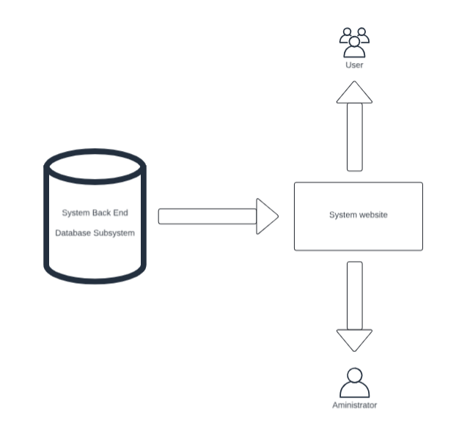
Preliminary Design
Subsystem Diagram

Slide 7
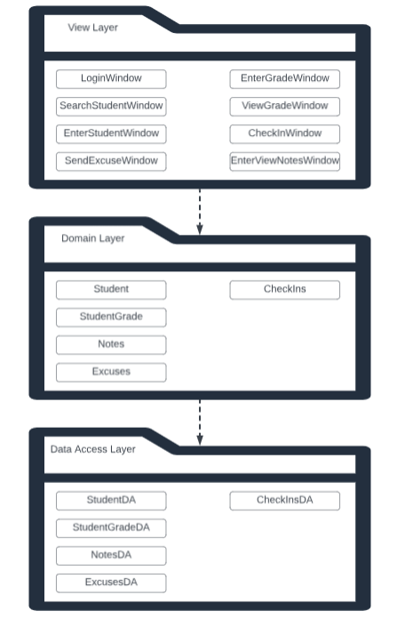
Package Diagram

Slide 8
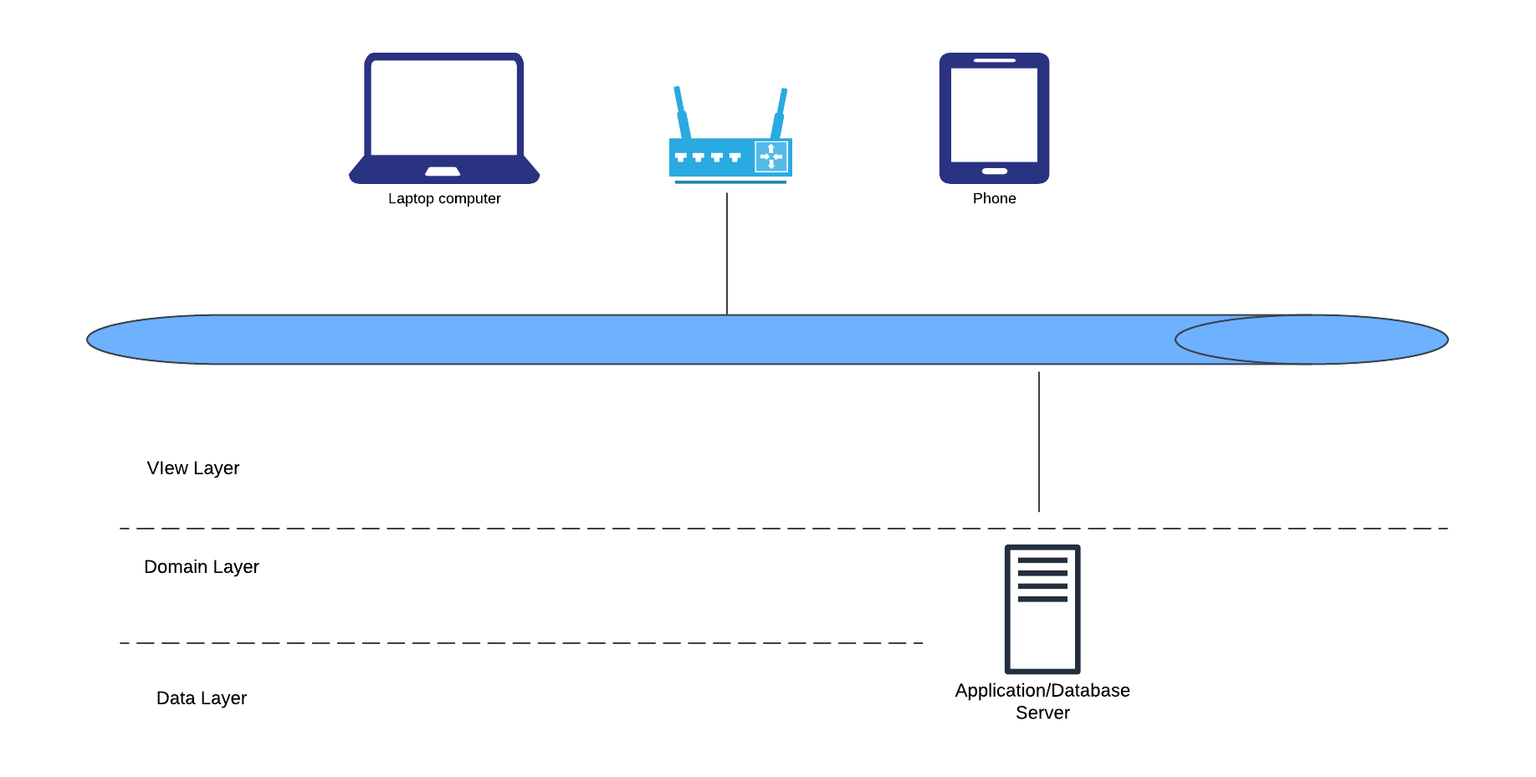
Deployment Diagram

Slide 9
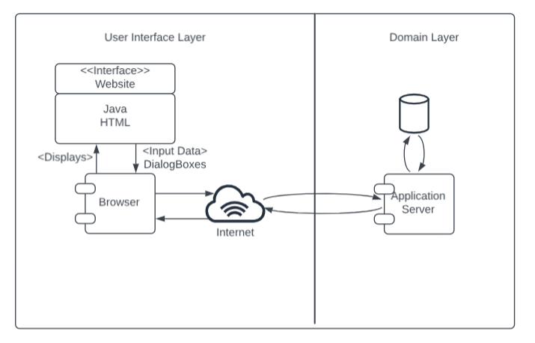
Component Diagram

Slide 10
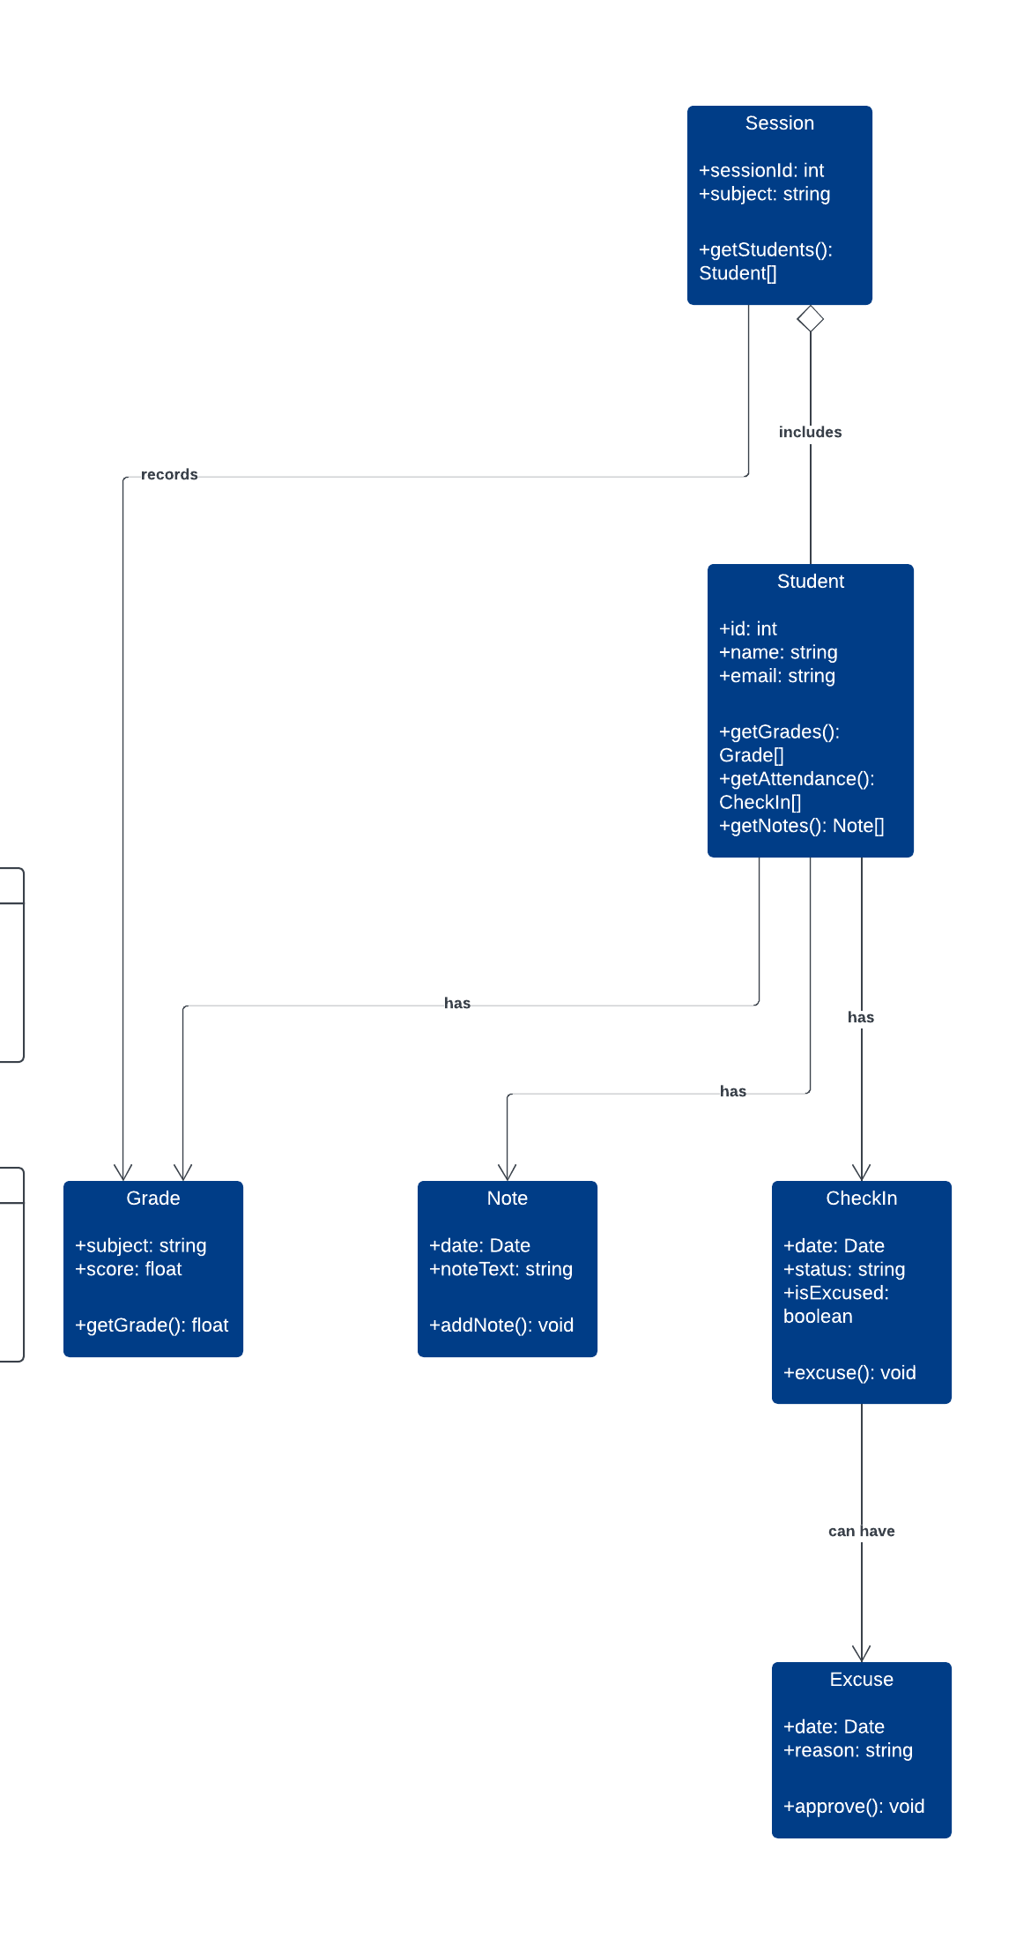
Detailed Design
Class Diagram

Slide 11
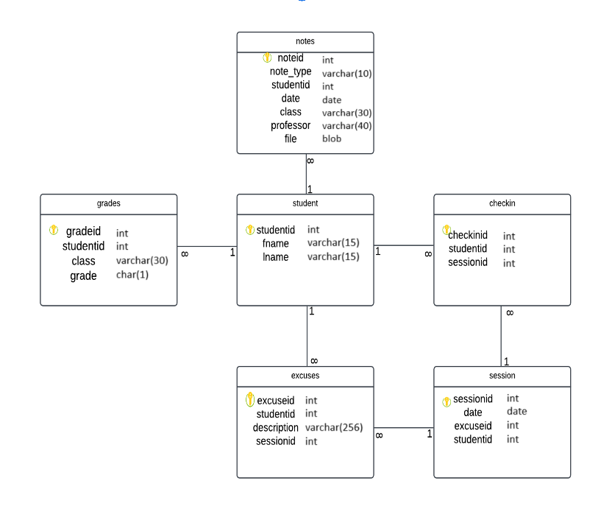
Database Design

Slide 12
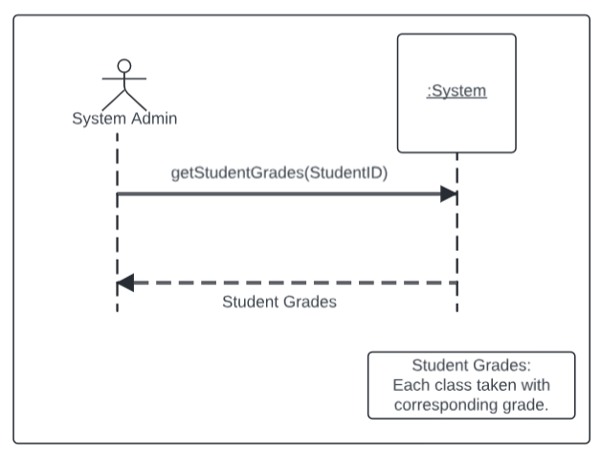
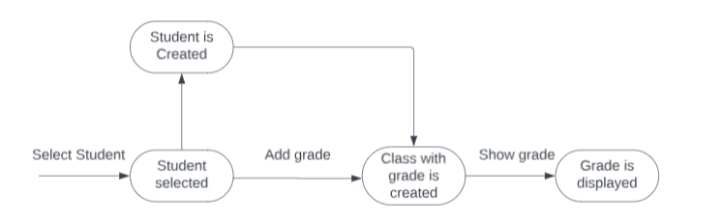
Detailed Design Pt 2
State Machine Diagram
System Sequence Diagram

Slide 13
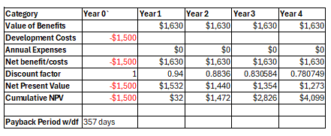
Project Management
Net Present Value and Payback Period
Net Present Value and Payback Period Calculation

Slide 14
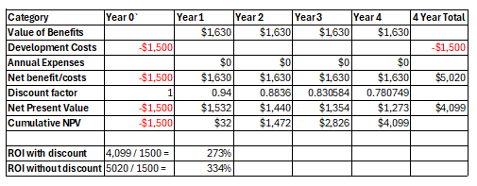
Project Management (continued)
Return on Investment Calculation
Return on Investment Calculation

Slide 15
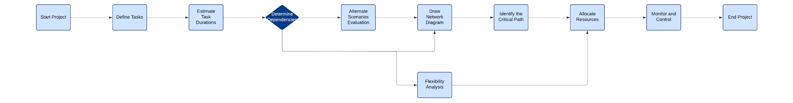
Project Management
PERT Chart
CPM Chart

Slide 16
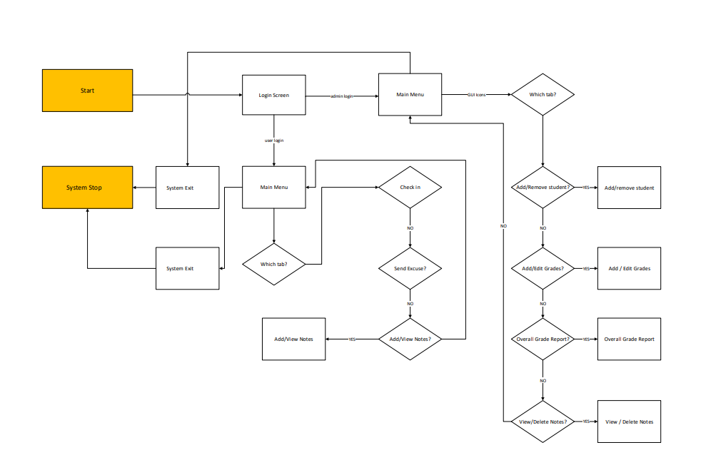
Navigation Diagram
Mockup of Prototype

Slide 17
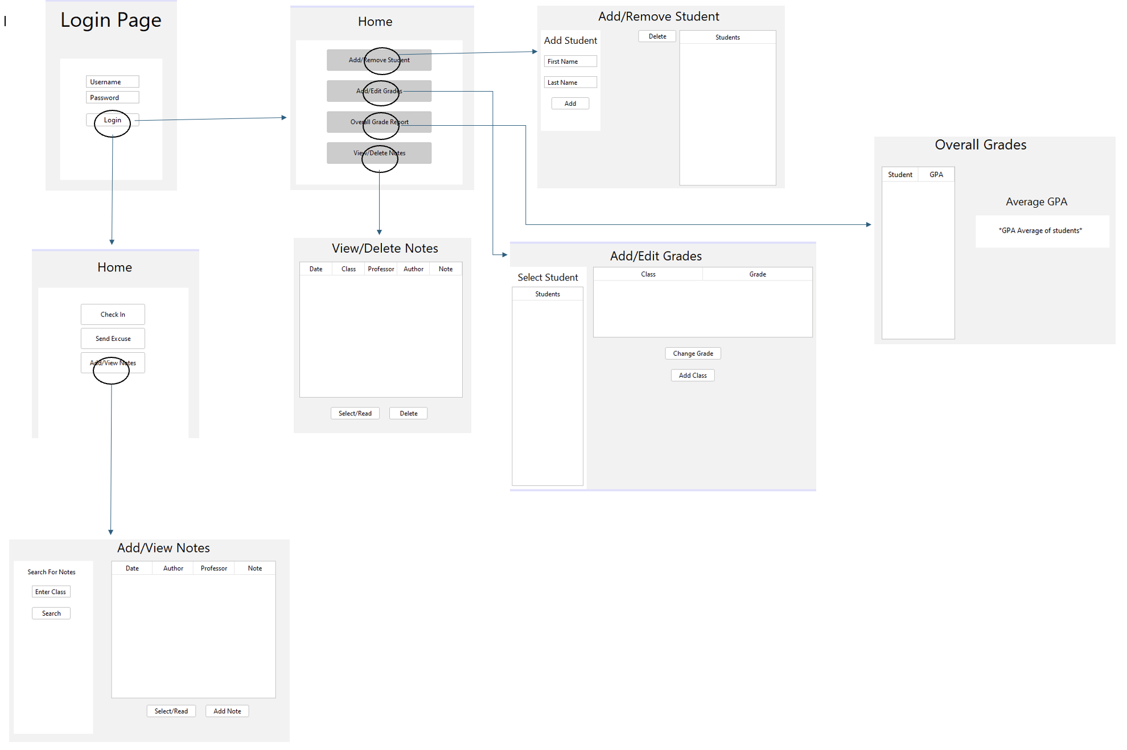
Mockup Pt 2
Refined Navigation Diagram

Slide 18
Final Presentation CIS-330
Carson Kerr, Gunnar Schmidt, Jonathan Perry, John Allen Stogner

